Slide 1

Agenda of JavaScript
1
Introduction
4
Regular Expressions
2
Fundanmentals
5
3
Type Conversion
6
4
Functions
7

Slide 2
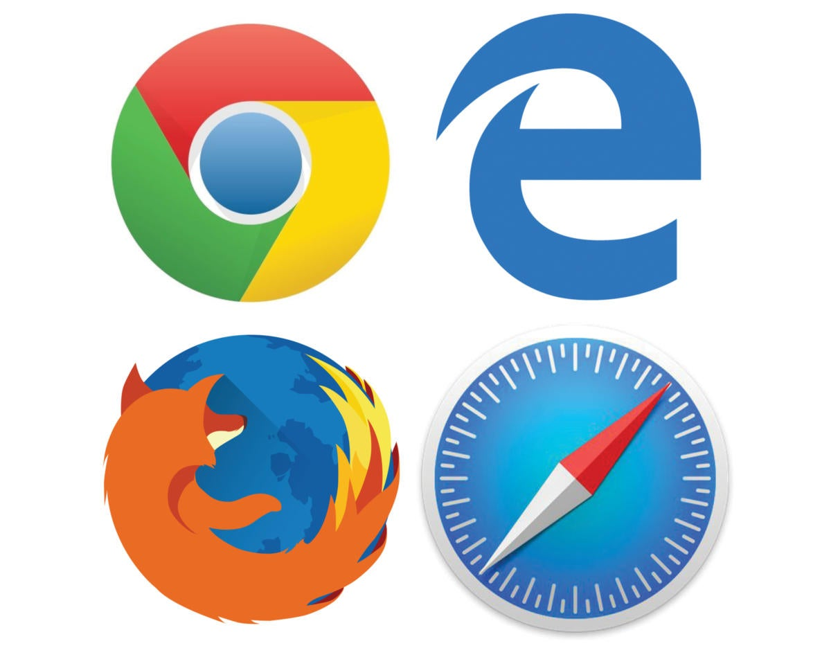
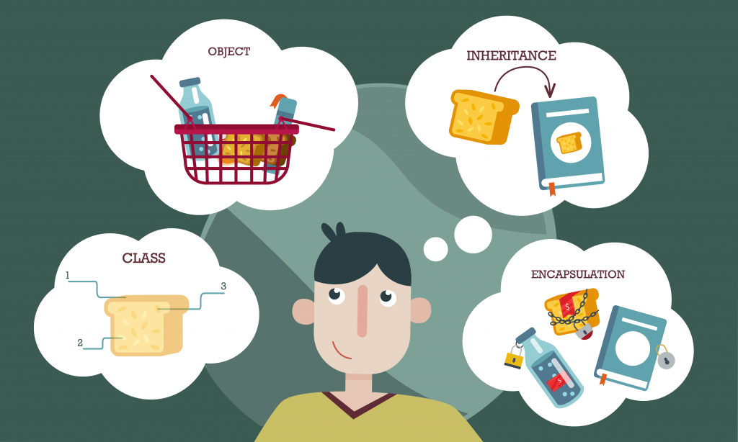

Supports of JavaScript
Object-based Scripting Language
It supports poymorphism, encapsulation and to some extent inhertance as well
JavaScript runs in a Broweser
JavaScript can execute not only in the browser buy also on the server and device which has a JavaScript Engin.

Slide 3
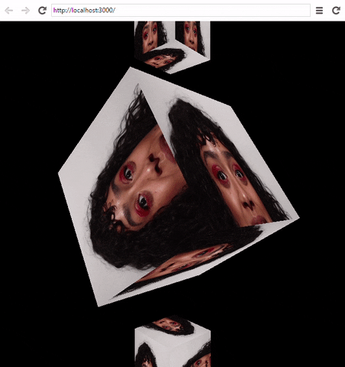

WHAT IS JAVASCRIPT ?
Javascript is a high level, interpreted, programming language used to make web page more interactive . It let’s you implement complex and beautiful things/design on web page.
Any Query put ?

Slide 4



WHAT IS JAVASCRIPT ?

Slide 5
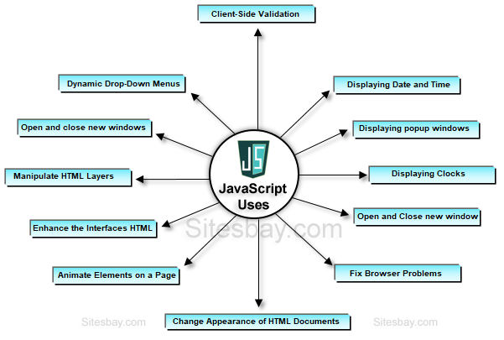
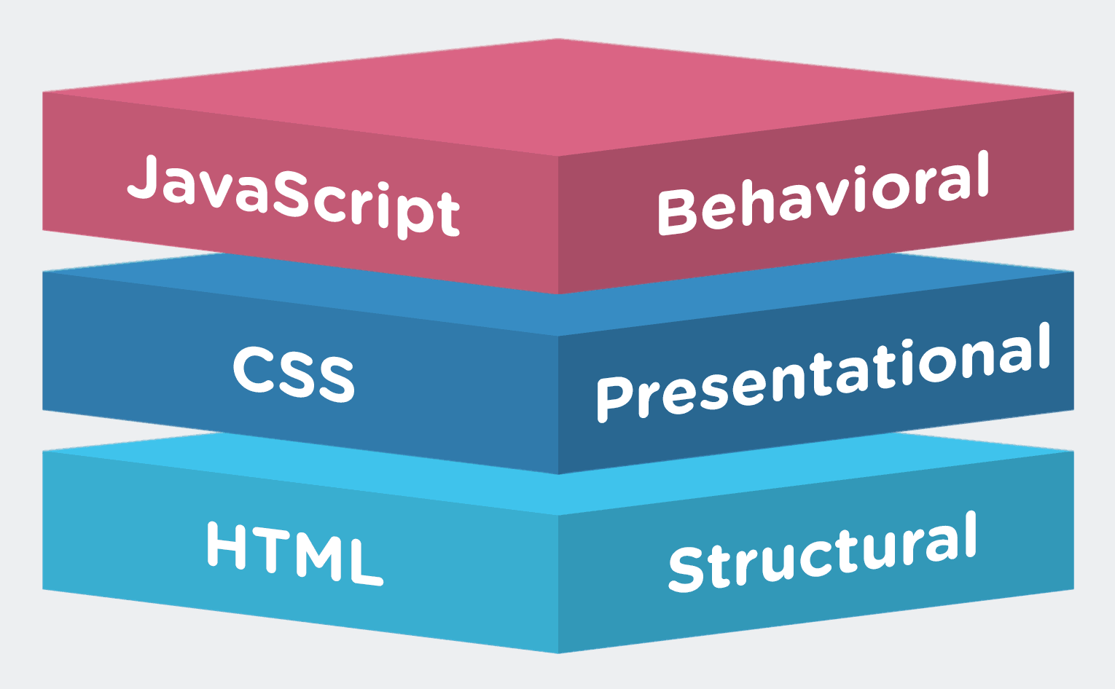
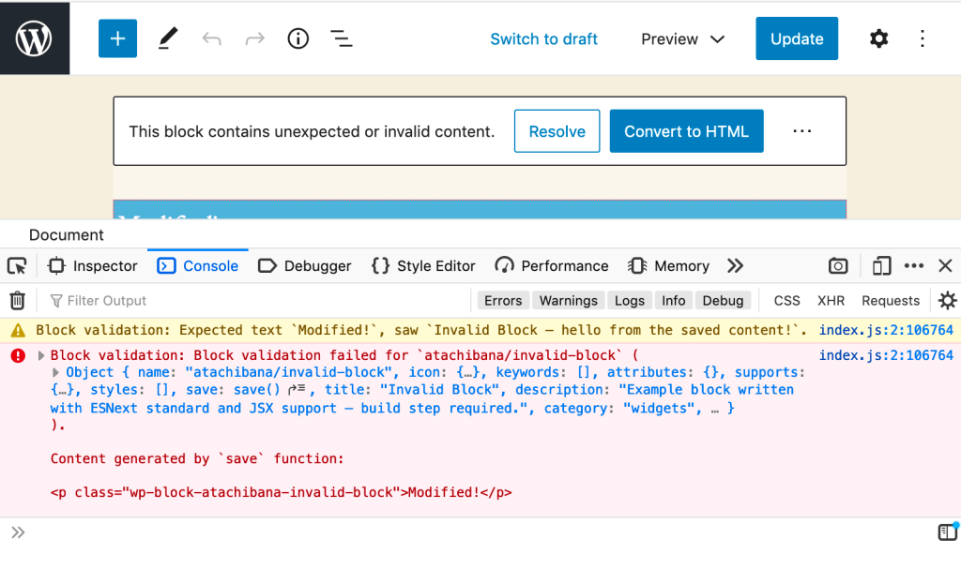
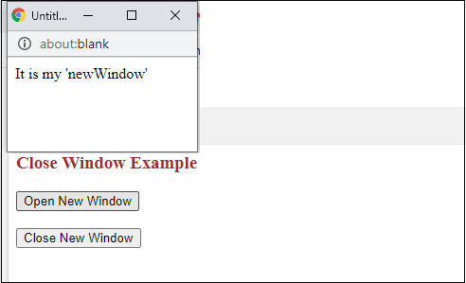
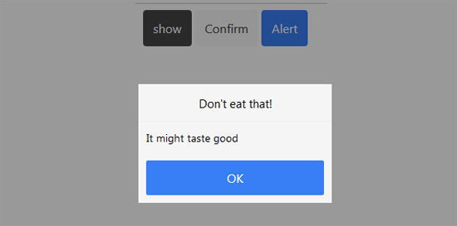
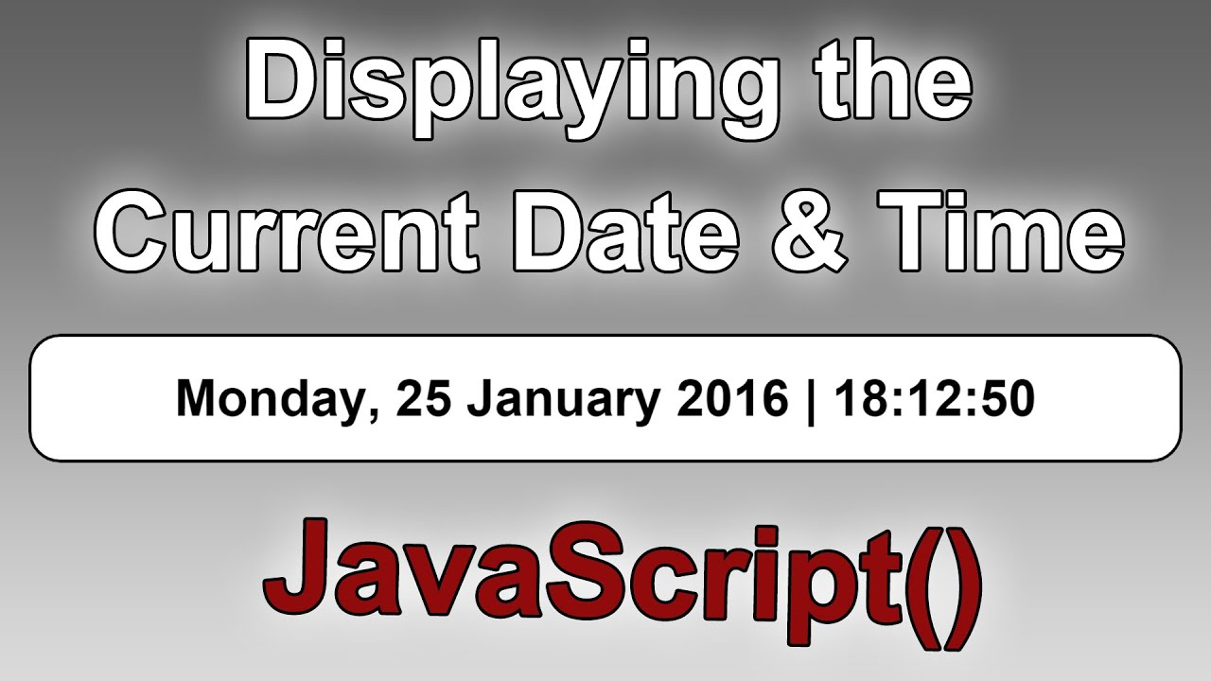
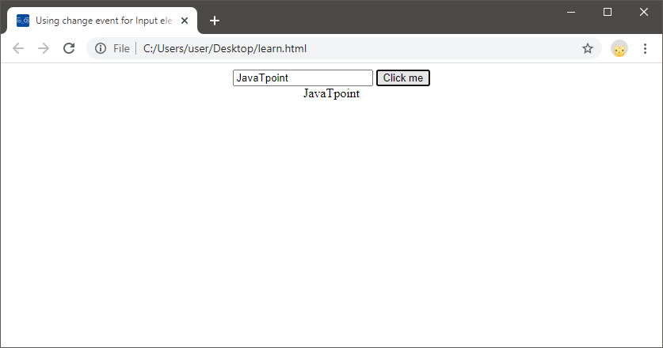
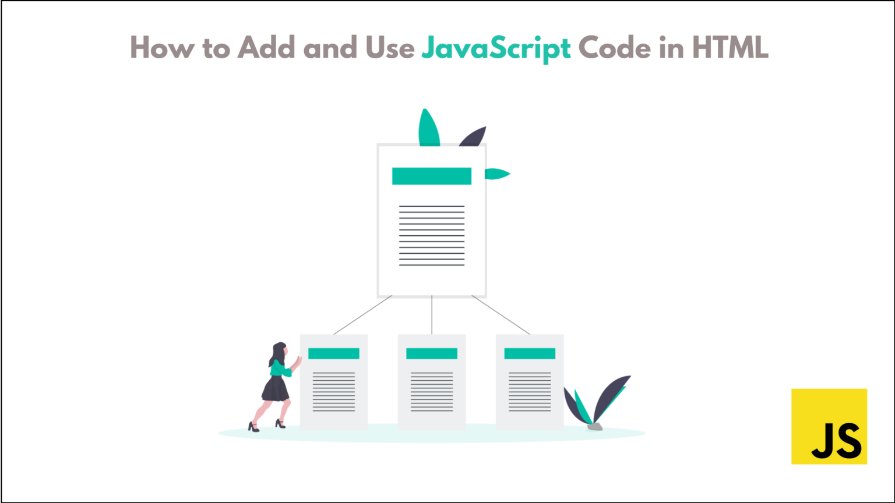
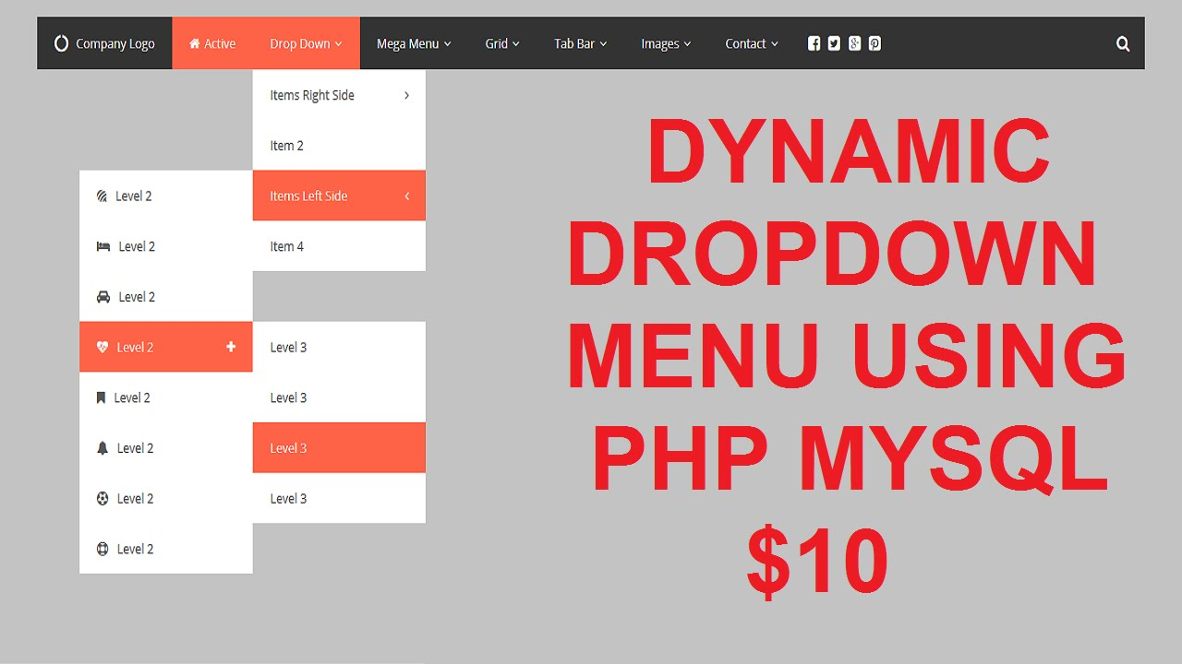
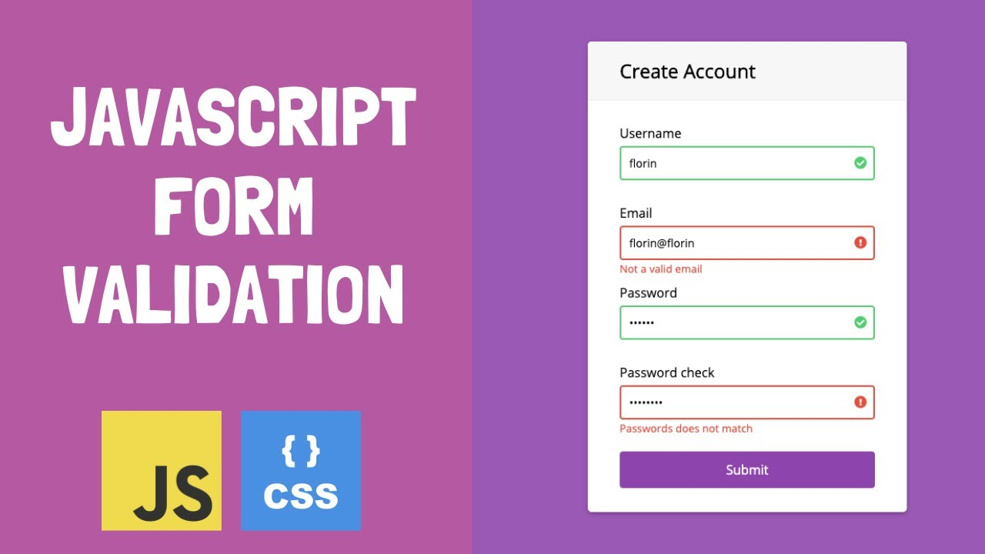
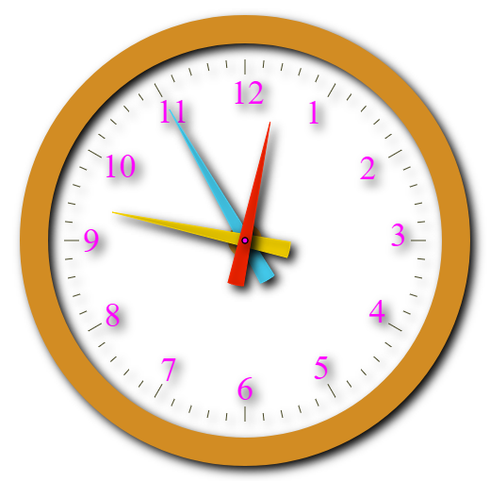
What are used JavaScript

Slide 6
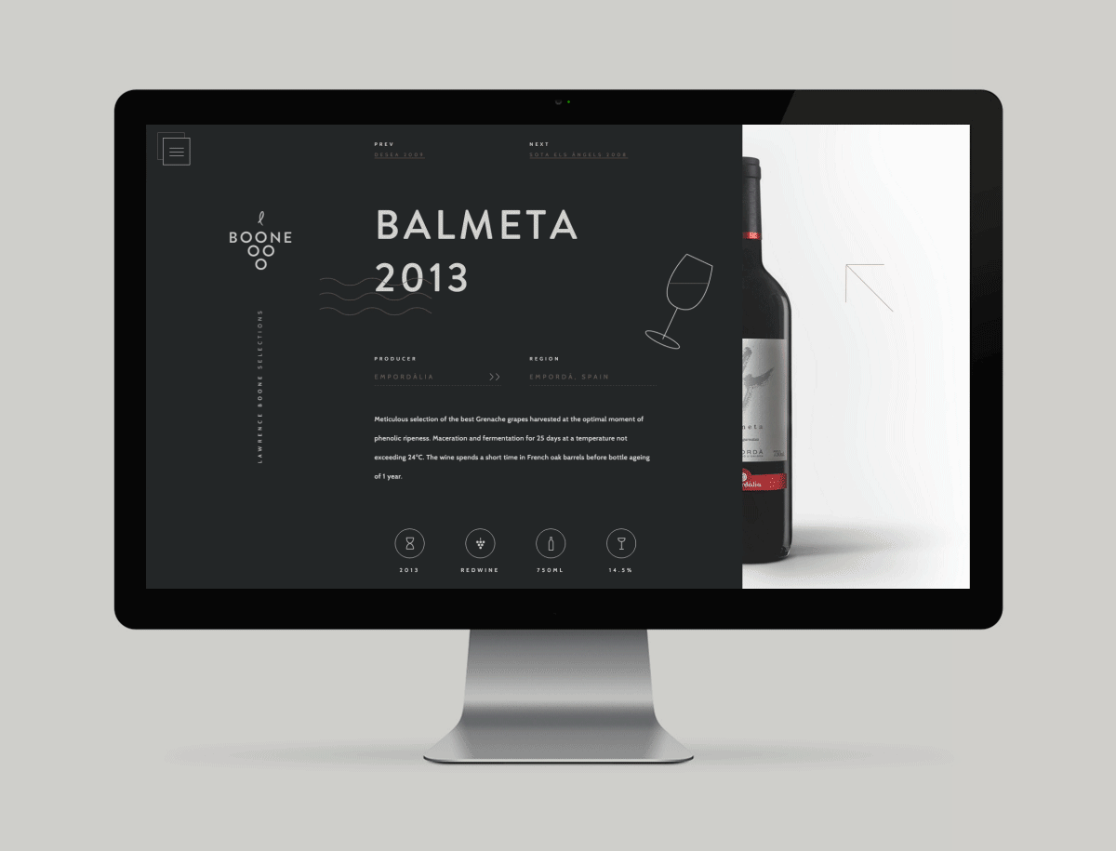
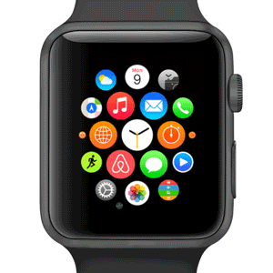
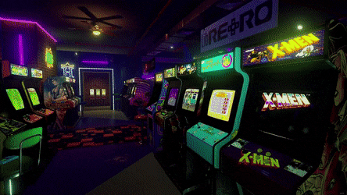
What can Do JavaScript
Web Application
Smart Watches
Games

Slide 7




JavaScript Frameworks

Slide 8



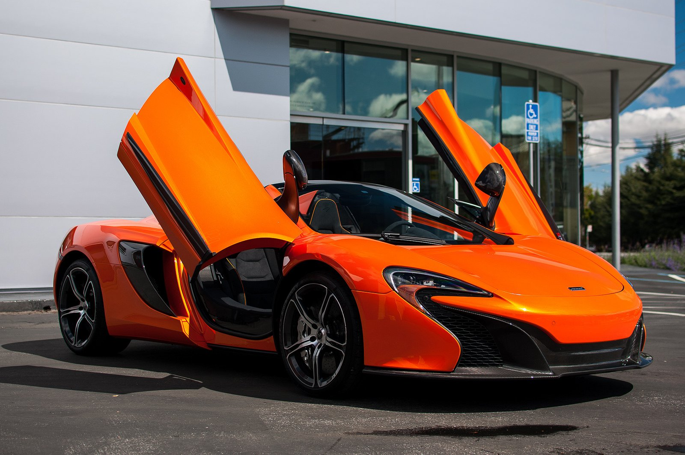
Relation B/w html, css & js
Stands for "Cascading Style Sheet." Cascading style sheets are used to format the layout of Web pages.
Hypertext Markup Language, a standardized system for tagging text files to achieve font, colour, graphic, and hyperlink effects on World Wide Web pages.
an object-oriented computer programming language commonly used to create interactive effects within web browsers

Slide 9
Benefits of JavaScript
Trust is everything
Client-Site Worker
Completely indepentdent
Easy to Learn
Powerful as nothing else
Targeted
Unique Features
Multi-fundanebtal website development

Slide 10
Fundamentals of JavaScript
Variables
Function
Constants
Conditional Statement
Data Types
Loops
Objects
Switch Case
Arrays

Slide 11
Variables
Memory Location
Syntax:
1. var a = 15;
2. let age;
age = 12;

